Slide 1
U.S. IP Litigation
Year in Review
Berkeley Law IP & Tech Month 2024
  Brett Schuman & Andrew Ong
1

Slide 2
LKQ Corp. v. GM Global Tech. Operations LLC
Non-obviousness of design patents should be assessed using the Graham test; the same test used for utility patents
PATENT LAW

Slide 3
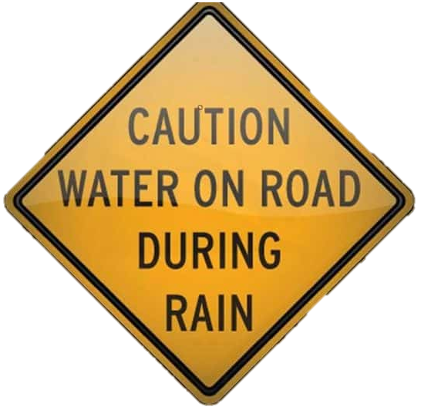
LKQ Corp. v. GM Global Tech. Operations LLC
The Claims
LKQ filed a petition for inter partes review of a GM patent arguing that GM’s design was obvious.
LKQ also argued that the Rosen-Durling test of non-obviousness should be overturned because it is analogous to the Teaching, Suggestion, and Motivation (“TSM”) test rejected in KSR

Slide 4
LKQ Corp. v. GM Global Tech. Operations LLC
Rosen and Durling
Together established the test of non-obviousness in design patents as follows:
    Step 1: Identify a piece of prior art so similar as to be basically the same as the claimed design, called a primary reference (“PR”). If no PR is found, the inquiry ends.
    Step 2: If a primary reference is found, secondary references (“SR”) may be used, but the SR must be so related to the PR that the appearance of the features in one would suggest the application of those features to the other.
Graham
Four factor test of non-obviousness in utility patents as follows:
    Scope and content of the prior art
    Differences in prior art and claimed design
    Level of ordinary skill in the art; and
    Secondary considerations: commercial success, long felt but unsolved need, and failure of others

Slide 5
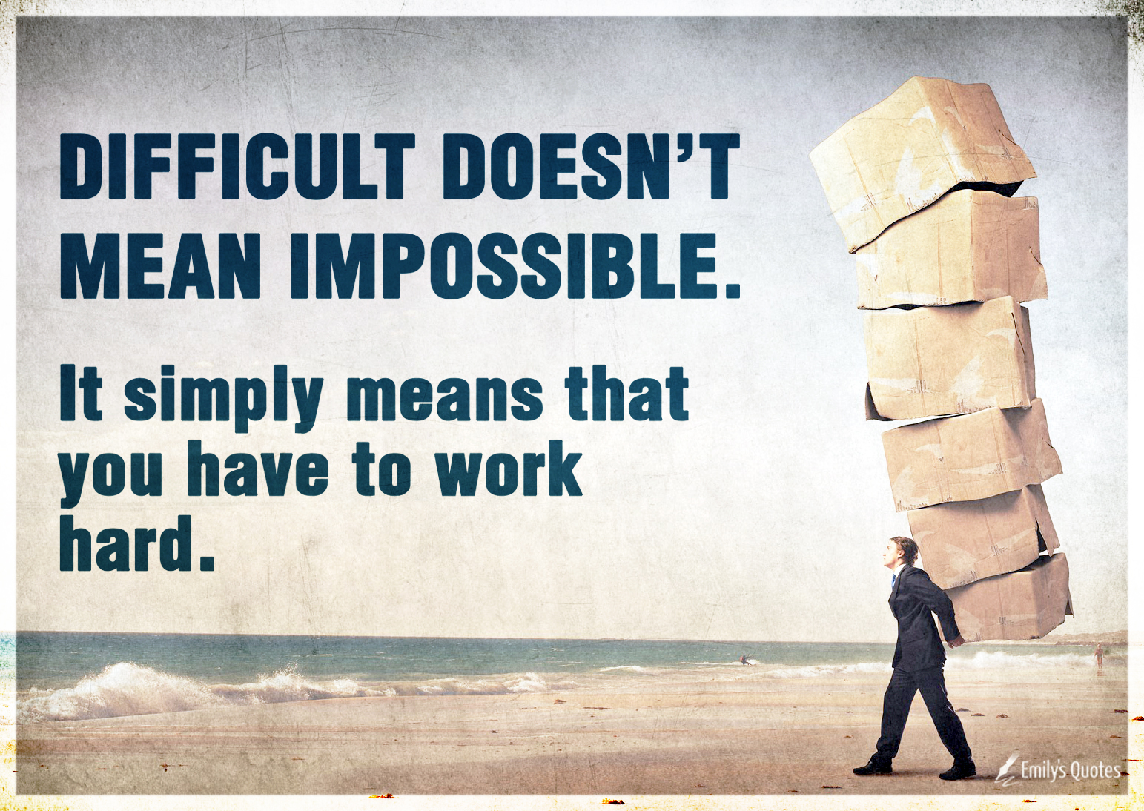
LKQ Corp. v. GM Global Tech. Operations LLC
The Ruling
The court overturned Rosen and Durling and adopted the Graham test for design patents
Reasoning that in KSR the court rejected the TSM test as rigid and imposing limitations absent from the Graham test
    Under TSM, claims were obvious only if some teaching, motivation, or suggestion to combine teachings existed in the prior art, the nature of the problem, or the knowledge of a person of ordinary skill in the art.
  Rosen-Durling was rejected for the same reasons that the TSM test was rejected in KSR
    Likely Impact
    The Graham test will likely make it harder to get and easier to challenge design patents because its flexibility allows for a much broader consideration of prior art. The now overturned Rosen-Durling test limited the prior art available for an obviousness claim.

Slide 6
Amarin Pharma, Inc. v. Hikma Pharmaceuticals USA Inc.
A Brand may plead that a Generic’s public statements and marketing materials in combination with their skinny label induced infringement
104 F.4th 1370 (Fed. Cir. 2024)
PATENT LAW

Slide 7
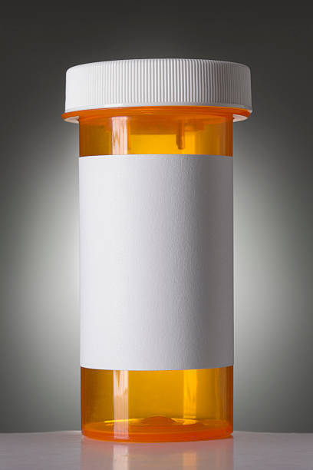
Amarin Pharma v. Hikma Pharmaceuticals
Amarin’s Complaint
Amarin sells a product called Vascepa. Originally, FDA approved for (1) treatment of severe hypertriglyceridemia; later FDA approved also for (2) lowering triglyceride levels.
Hikma received approval to sell generic for use (1), but then more broadly marketed as generic Vascepa, with no limitation on use.
Amarin alleged that a Hikma drug skinny label, combined with Hikma’s public statements and marketing materials, induced infringement of patents listed in the Orange Book.
The district court granted Amarin’s motion to dismiss, reasoning that neither the label in isolation nor the public statements and marketing materials in isolation could plausibly induce infringement.
Amarin appealed.

Slide 8

Amarin Pharma v. Hikma Pharmaceuticals
The Federal Circuit
Reversed district court’s dismissal of the complaint, finding that the brand’s allegations as outlined in its complaint at least plausibly state a claim for induced infringement.
The Federal Circuit noted this is not a traditional ANDA case in which the patent owner seeks to establish that if a generic manufacturer's drug is put on the market, it would infringe the asserted patent.
It also is not a section viii case, in which the patent owner's claims rest solely on allegations that the generic manufacturer's proposed label is “not skinny enough,” such that the label alone induces infringement.
The Federal Circuit explained that the totality of the allegations, as a whole and not piecemeal, taken as true determine whether a brand has plausibly pled inducement, emphasizing that the district court’s approach of examining each part in isolation was incorrect.
Likely Impact
It may be easier for a brand to survive a motion to dismiss because brands can allege facts beyond the label that when viewed in combination with the label may indicate inducement of infringement.

Slide 9
Edwards Lifesciences Corp. v. Meril Life Sciences Pvt. Ltd.
Under the Patent Act’s safe harbor provision, so long as a use is reasonably related to the development of information for FDA approval, the intent of the parties and non-FDA approval of other uses are irrelevant to the safe harbor provision.
96 F.4th 1347 (Fed. Cir. 2024)
PATENT LAW

Slide 10
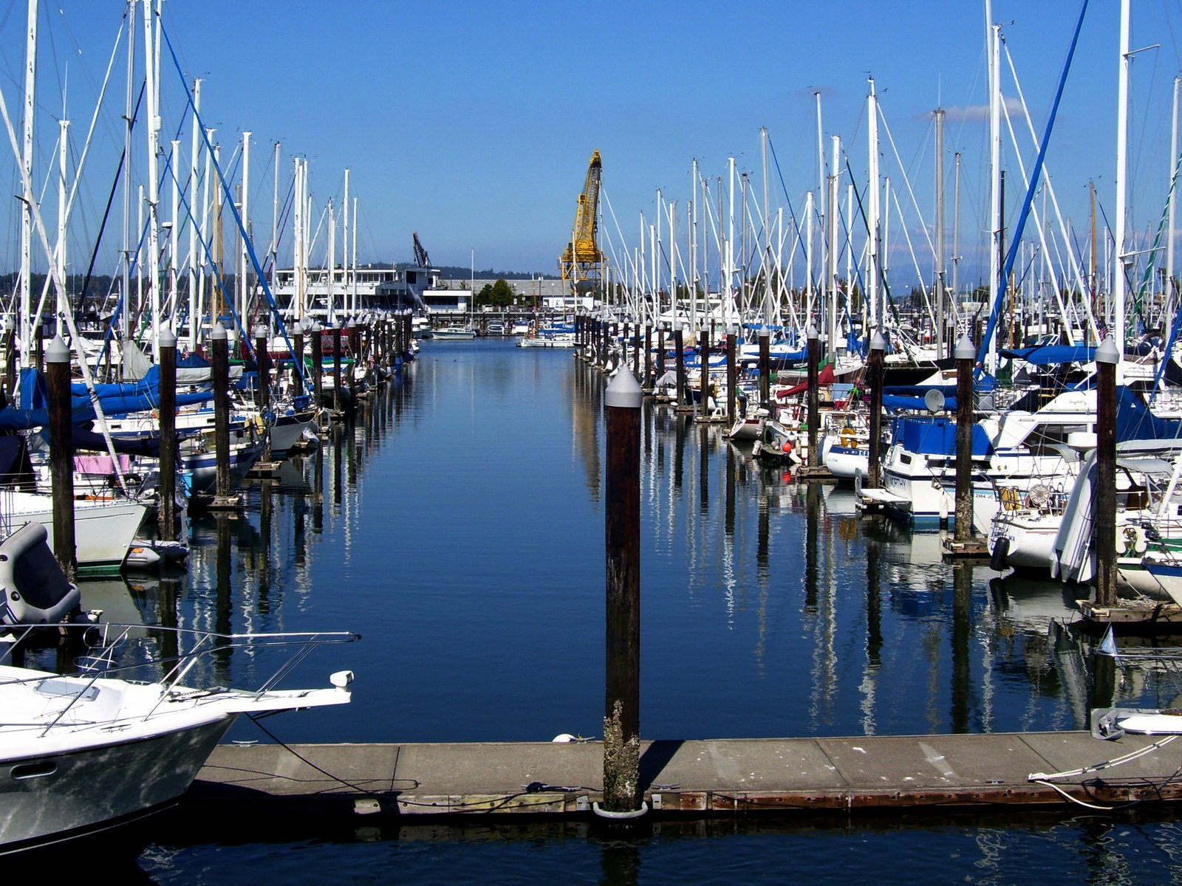
Edwards Lifesciences v. Meril Life Sciences
Facts
    Meril, an India-based medical device company, imported infringing medical devices into the US. The devices were never shown or used, nor were they sold or offered for sale.
    Edwards sued Meril alleging infringement.
    Meril invoked the safe harbor provision of the Patent Act.
    The district court granted summary judgment of non-infringement, holding that Meril’s importation of medical devices fell within the safe harbor provision since Meril’s actions were reasonably related to developing information for an FDA approval.

Slide 11
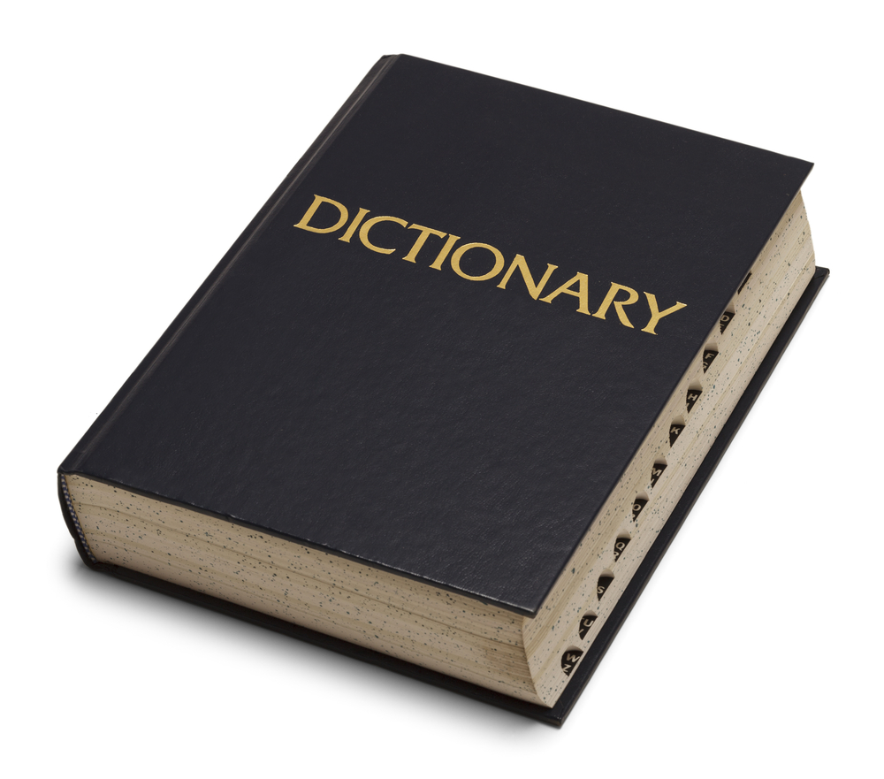
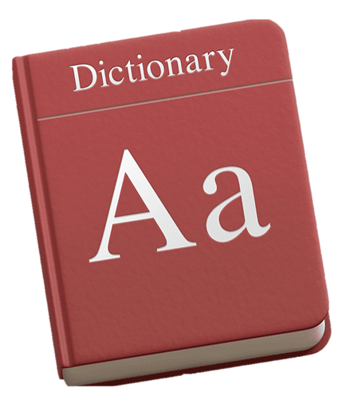
Edwards Lifesciences v. Meril Life Sciences
The Meaning of “Solely”: Majority v. Dissent
    The safe harbor provision reads “It shall not be an act of infringement to make, use, offer to sell, or sell within the United States or import into the United States a patented invention ... solely for uses reasonably related to the development and submission of information under a Federal law which regulates the manufacture, use, or sale of drugs ....” 35 U.S.C §271(e)(1).
Majority
    Reasoned that “solely” applies only to “for uses”, Thus, safe harbor only covers acts or uses that bear a reasonable relationship to the development and submission of information to the FDA.
    Also relied on three rulings indicating intent and the presence of other non-FDA purposes are irrelevant to whether safe harbor applies. See Abtox, Momenta, and Amgen
Dissent
    Dissent argued that “solely” creates a safe harbor only for uses, sales, and importations that are solely for the development of information for the FDA, insisting that the purpose of the use and a party’s intent is relevant to the safe harbor analysis.
    Under the dissent’s paradigm, if a use, sale, or importation has some purpose other than development of information for the FDA, it is not within the bounds of the safe harbor provision.

Slide 12
Edwards Lifesciences v. Meril Life Sciences
    Edwards has requested a full review.
    If a rehearing is not granted, Edwards will likely appeal to the Supreme Court.
Likely Impact
    The ruling appears to favor potential infringers, as a potential infringer may fall within the Patent Act’s safe harbor so long as it can demonstrate that its activities are reasonably related to development and submission of information for FDA approval, even if the activities also have non-FDA approval purposes.

Slide 13
Warner Chappell Music, Inc. v. Nealy
Where the discovery rule applies, copyright plaintiff may seek damages beyond the three-year limit.
601 U.S. 366 (2024)
COPYRIGHT LAW

Slide 14
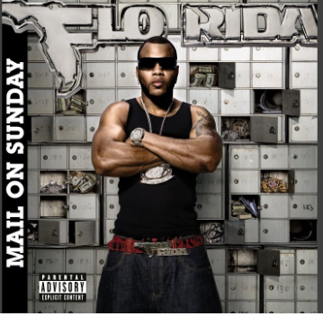
Warner Chappell Music, Inc. v. Nealy
Copyright Act
“No action shall be maintained under the provisions of this title unless it is commenced within three years after the claim accrued.” 17 U.S.C. §507(b)
WHEN does a copyright claim accrue? Two views:
      When a plaintiff discovers, or should have reasonably discovered, an infringement → Discovery Rule (majority)
      When the infringement actually happened
Facts
Nealy and Butler formed Music Specialist, Inc. (MSI). Unbeknownst to Nealy, Butler started granting licenses for MSI’s musical works to Warner Chappell.
In 2018, Nealy sued Warner Chappell (WC) for copyright infringement and claimed:
      Infringing acts dated back to 2008. (10 years before he filed suit.)
      He did not learn of infringing conduct until 2016. (Less than 3 years before he sued, so discovery rule may apply.)

Slide 15
Warner Chappell Music, Inc. v. Nealy
SCOTUS: NO three-year limit on damages.
Under the discovery rule, a copyright plaintiff can recover damages for infringing acts that occurred more than three years before filing of lawsuit.
The three-year damages bar essentially “guts” or “silently eliminates” the discovery rule.
Clarified Petrella decision and stated the Second Circuit took it out of context:
      In Petrella, the discovery rule did not apply. The plaintiff filed the lawsuit more than three years after discovering infringement.
      The Court’s statement that the Copyright Act allows plaintiffs “to gain retrospective relief running only three years back from” the filing of a lawsuit was only made in context of a plaintiff who could not use the discovery rule.

Slide 16
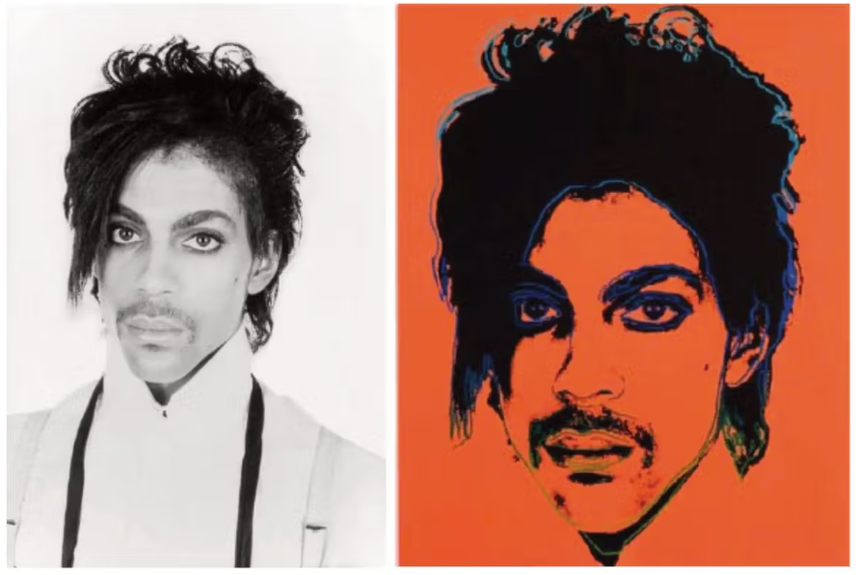
Fair Use Cases Post-Warhol
Andy Warhol Found. for the Visual Arts, Inc. v. Goldsmith,
598 U.S. 508 (2023)
COPYRIGHT LAW

Slide 17
Andy Warhol Found. for the Visual Arts, Inc. v. Goldsmith
Warhol created a derivative work (“Orange Prince”) of Goldsmith’s photo of Prince. The Andy Warhol Foundation (AWF) licensed it to a magazine for use in its publication.
Goldsmith sued AWF for copyright infringement.
FAIR USE FACTORS – secondary use of a copyrighted work constitutes fair use?
    Purpose and character of the use, including whether such use is:
      Transformative
      Of a commercial nature or for nonprofit educational purpose
    Nature of the copyrighted work
    Amount and substantiality of the portion used in relation to the copyrighted work as a whole
    Effect of the use upon the potential value for or value of the copyrighted work

Slide 18
Andy Warhol Found. for the Visual Arts, Inc. v. Goldsmith
SCOTUS: No Fair Use – Warhol’s “Orange Prince” is NOT transformative
“If an original work and a secondary use share the same or highly similar purposes, and the secondary use is of a commercial nature, the first factor of fair use defense to copyright infringement, purpose and character of use, is likely to weigh against fair use.” (emphases added)
  Goldsmith’s “original photograph and AWF’s copying use of it share substantially the same purpose” because both are “portraits of Prince used to depict Prince in magazine stories about Prince.”
  AWF’s secondary use of the photo was “of a commercial nature” as it licensed out for $10,000.

Slide 19
Philpot v. Independent Journal Review
When both the original and secondary uses of a copyrighted photo serve to depict the photographed figure, they share substantially the same purpose, and there is no transformative use.
92 F.4th 252 (4th Cir. 2024)
COPYRIGHT LAW

Slide 20
Philpot v. Indep. J. Rev.
Background
Philpot took photo of musician Ted Nugent (“the Photo”), which Independent Journal Review (IJR) used in an online article and failed to include the required attribution.
Philpot sued IJR for copyright infringement. IJR argued fair use defense.
District court held for IJR. Philpot appealed. Fourth Circuit reversed.
Fourth Circuit: No fair use defense.
Secondary use of the photo was not transformative
“Here, as in Warhol, Philpot took the Photo to capture a ‘portrait’ of Nugent, and IJR used the Photo to ‘depict’ the musician. Accordingly, the two uses ‘share[d] substantially the same purpose.’” (emphases added)

Slide 21
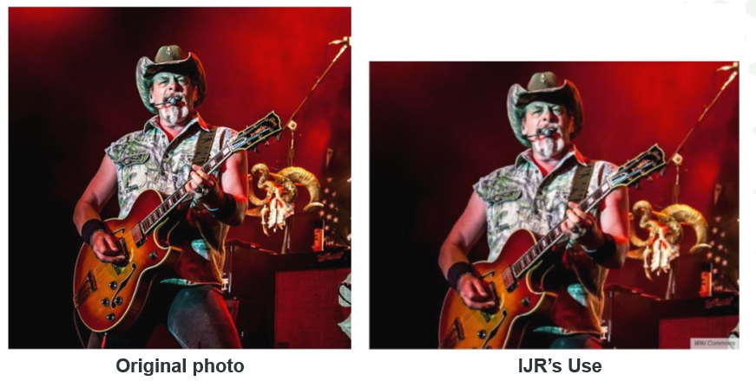
Philpot v. Indep. J. Rev.
“Indeed, IJR has less of a case for ‘transformative’ use than the [AWF] did in Warhol. Unlike the orange dubbing in that case, IJR did not alter or add new expression to the Nugent Photo beyond cropping the negative space.”

Slide 22
August Image, LLC v. Girard Entertainment & Media LLC
A copyrighted photo included in a social media post is transformative if the purpose is to report or comment on the post.
2024 WL 1375480 (S.D.N.Y. 2024)
COPYRIGHT LAW

Slide 23
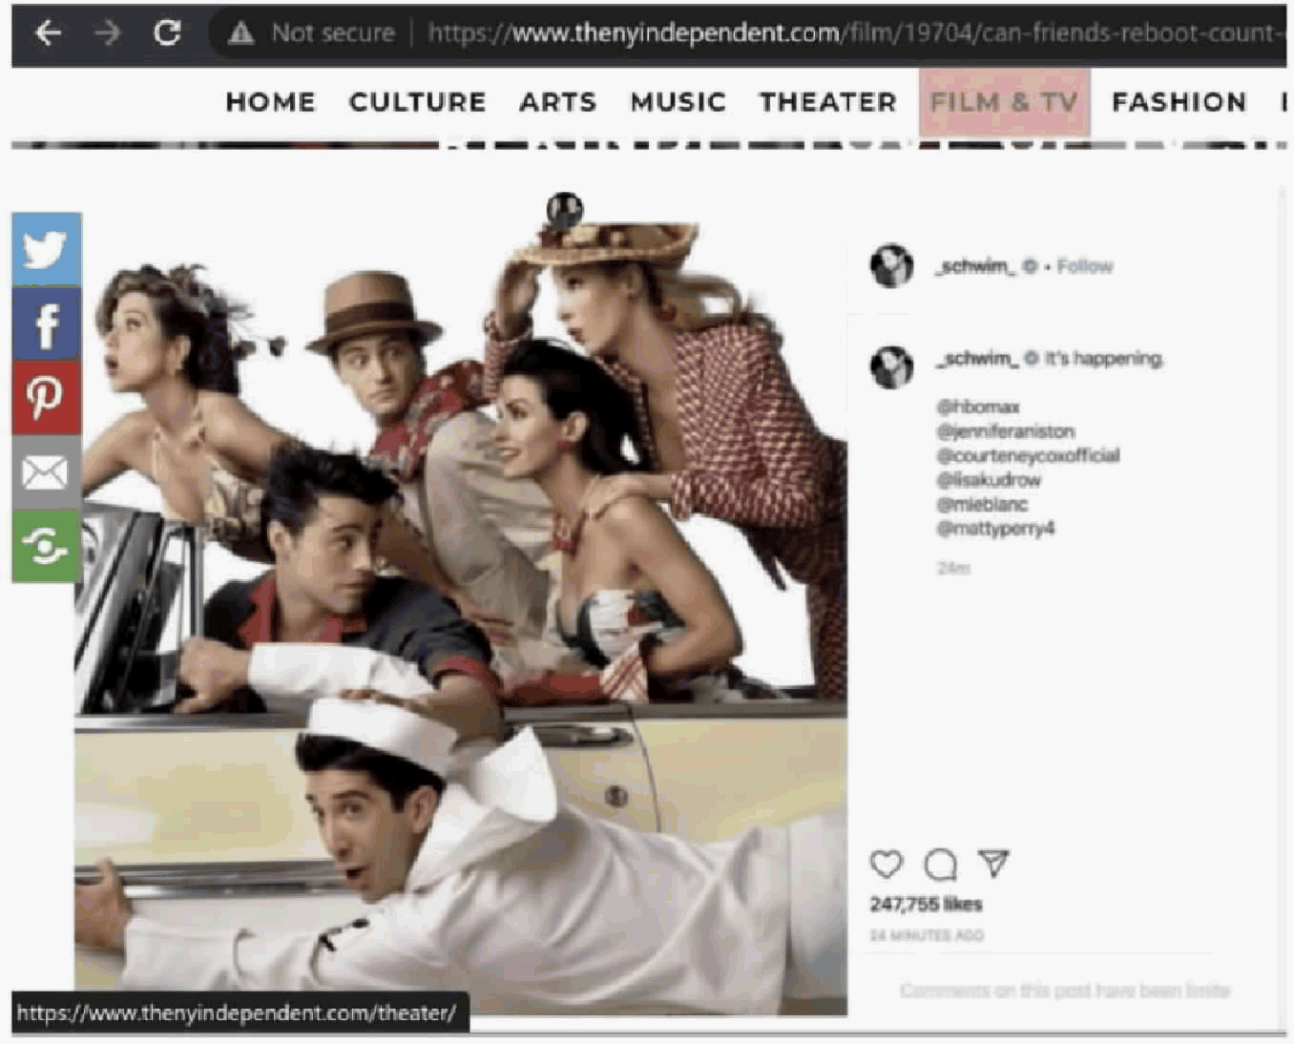
August Image, LLC v. Girard Entertainment & Media LLC
August Image, LLC owns right to sue for copyright infringement of a photo of the cast of Friends (the “Photograph”)
David Schwimmer, a cast member of Friends, used the Photograph in an Instagram post and captioned it with “It’s happening.”
Defendants, owners of website, used a screenshot of Schwimmer’s post in an article titled “Can Friends Reboot Count on Aging Fans to Rekindle Love of TV Show?”

Slide 24
August Image, LLC v. Girard Entertainment & Media LLC
S.D.N.Y. court upheld fair use defense
“[P]ublishing a copyrighted photograph included in a social media post is transformative when the purpose is to report or comment on the post, which is itself the subject of the story.”
The “Article's focus was on the fact that Schwimmer's Instagram Post of the Photograph with the caption ‘It's happening[ ]’ suggested that the popular sitcom would return; the inclusion of the Photograph was incidental. … That purpose is wholly distinct from the purpose for which the Photograph was taken, which was to depict the cast of Friends.”
Case is currently on appeal to Second Circuit.

Slide 25
Whyte Monkee Productions LLC v. Netflix, Inc.
Secondary use of a film clip must involve a commentary on the original work itself to be transformative.
97 F.4th 699 (10th Cir. 2024)
*Opinion vacated, granted en banc panel rehearing.
*Oral arguments heard on July 10, 2024.
COPYRIGHT

Slide 26
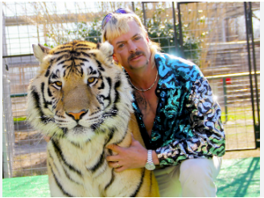
Whyte Monkee Productions LLC v. Netflix, Inc.
    Plaintiff Sepi alleged Netflix used its copyrighted videos without permission in the documentary “Tiger King”
    District court granted summary judgment in favor of Netflix and held use of one of the videos constituted fair use
    Tenth Circuit reversed “in light of the Supreme Court’s recent guidance in Warhol”
      Warhol “clarified that Campbell cannot be read to mean [that] … any use that adds some new expression, meaning, or message” weighs in favor of fair use under the first factor.

Slide 27
Whyte Monkee Productions LLC v. Netflix, Inc.
Tenth Circuit: No Fair Use
    Instead, the use must involve a commentary on the original work itself.
    Here, “[Netflix’s] use did not comment on Mr. Sepi’s video, … but rather targeted a character in the composition. And Warhol has deemed such a use to not be sufficiently transformative.”
    Netflix used the video to comment on Joe Exotic, specifically “to illustrate Mr. Exotic’s purported megalomania, even in the face of tragedy.” This only “provid[ed] a historical reference point in Mr. Exotic’s life and comment[ed] on [his] showmanship.”
    BUT on May 2024, Tenth Circuit vacated this decision and granted an en banc panel rehearing.
July 2024: Oral argument focused on fair use as applied to the use of film clips in documentaries and the impact of the Warhol decision on such.
Opinion is pending.

Slide 28
Motorola Sols., Inc. v. Hytera Commc’ns Corp. Ltd.
DTSA allows parties to sue for trade secret misappropriation occurring anywhere in the world.
108 F.4th 458 (7th Cir. 2024)
TRADE SECRET

Slide 29
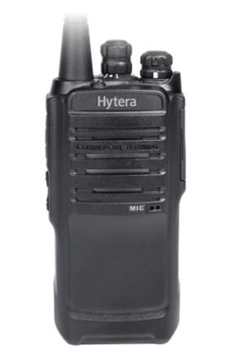
Motorola v. Hytera
Background
    Motorola accused Hytera of stealing its trade secrets to develop competing two-way radios.
    Hytera poached Motorola engineers in Malaysia and had them download thousands of confidential files, including Motorola’s trade secrets, before leaving Motorola.
    Using Motorola’s stolen tech, Hytera launched a line of radios that were “functionally indistinguishable” from Motorola’s and sold them in the U.S. and abroad.
    After trial, a jury found Hytera liable for trade secret misappropriation (and copyright infringement), awarding damages of $407.4 million in DTSA damages
    Seventh Circuit: Affirmed.

Slide 30
Motorola v. Hytera
    “Whether the DTSA rebuts the presumption against extraterritoriality … is a question of first impression for our circuit, and as far as we can tell, for any circuit.”
      RJR Nabisco two-part test for extraterritoriality
      Whether the presumption against extraterritoriality has been rebutted—that is, whether the statute gives a clear, affirmative indication that it applies extraterritorially
      If so, the scope of the statute “turns on the limits Congress has (or has not) imposed on the statute's foreign application.

Slide 31
Motorola v. Hytera
    “Neither the private right of action in Section 1836(b) of the DTSA nor the definition of misappropriation includes an express reference to extraterritorial conduct, BUT:
        Plain language of DTSA’s predecessor, Section 1837, Ch. 90: “This chapter also applies to conduct occurring outside the [U.S.] if … an act in furtherance of the offense was committed in the [U.S.].” (emphasis added)
        Congress made several references to extraterritorial conduct when it enacted the DTSA
    Regarding scope, there remained a question as to whether extraterritorial application of the original statute was limited only criminal matters.
    “Taken together, it is clear that Congress was concerned with actions taking place outside of the [U.S.] in relation to the misappropriation of the U.S. trade secrets when it passed the DTSA.”

Slide 32
Motorola v. Hytera
Significance of Extraterritorial Reach of DTSA
    DTSA allows parties to sue for trade secret misappropriation occurring anywhere in the world if an act in furtherance of the alleged misappropriation occurred in the U.S.
    Increases potential damages as recovery can now include global sales of products using misappropriated trade secrets
    Greater incentive to bring claims under DTSA

Slide 33
Cf. Patent Act’s Section 271(g) – Infringement by Importation
    “Whoever without authority imports into the [U.S.] or offers to sell, sells, or uses within the [U.S.] a product which is made by a process patented in the [U.S.] shall be liable as an infringer”
    Importing a product made abroad by a U.S. process patent is an act of infringement.
    Before 271(g), companies escaped patent infringement by making products overseas and then importing them to the U.S.
    Note: 271(g) is not an extraterritorial application of U.S. patent law. Act of importing into the U.S. is act of infringement.

Slide 34
Vidal v. Elster
The Lanham Act’s Names Clause does not violate the First Amendment.
602 U.S. 286 (2024)
TRADEMARK LAW

Slide 35
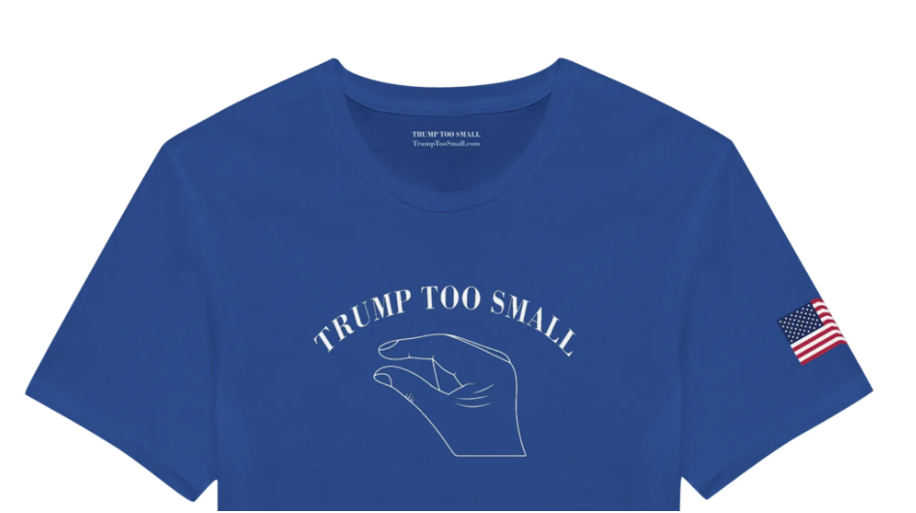
Vidal v. Elster
Background
    Elster wanted to register trademark “Trump too small,” accompanied by a hand gesture, for shirts and hats.
    The trademark references a moment from the 2016 Presidential primary debate between Trump and Rubio.

Slide 36
Vidal v. Elster
PTO Rejected Trademark (TTAB affirmed)
    Lanham Act’s Names Clause prohibits registration of a trademark that uses a name identifying a particular living individual except by his written consent.
    Elster’s mark used President Trump’s name without his consent.
    Elster argued this prohibition violated his First Amendment right to free speech.
Federal Circuit: Reversed – Names Clause violates First Amendment
Names Clause is a viewpoint-neutral, content-based restriction because it discriminates against trademarks that contain a living person’s name. Thus, it is subject to intermediate scrutiny.
Held: the Government failed to “satisfy even intermediate scrutiny because the names clause does not advance any substantial government interest.”

Slide 37
Vidal v. Elster
SCOTUS: Reversed (unanimous)
Names Clause does NOT violate First Amendment.
Majority Opinion: Historical precedent supports the Names Clause.
      Content-based speech restrictions are typically unconstitutional, but viewpoint-neutral, content-based trademark laws have long coexisted with the First Amendment.
      But acknowledges this historical approach may not apply universally to all trademark laws.
“This decision is narrow.”
“In a future case, we can address the ‘distinct question’ whether ‘a viewpoint-neutral, content-based trademark restriction’ is constitutional without ‘such a historical pedigree.’”
Note: The Court has twice ruled that certain Lanham Act provisions violate the First Amendment because they discriminate based on viewpoint.
      Matal v. Tam: A prohibition against disparaging trademarks was held unconstitutional.
      Iancu v. Brunetti: A prohibition against trademarks containing immoral or scandalous matter was held unconstitutional.

Slide 38
Brumfield v. IBG
Companies can recover damages for foreign conduct if they can show a “causal” relationship between the domestic infringement and the foreign conduct.
97 F.4th 854 (Fed. Cir. 2024)
PATENT LAW

Slide 39

Brumfield v. IBG
Damage Claims For Foreign Conduct
Trading Technologies appealed a decision excluding its damages expert’s testimony regarding foreign damages
The expert had framed the relationship between the domestic infringement and foreign conduct as causal; that is, that the foreign conduct was the foreseeable result of the infringing acts.

Slide 40
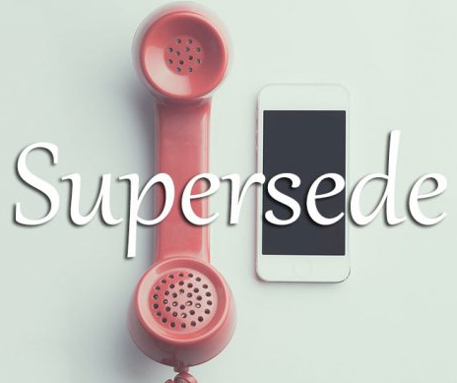
Brumfield v. IBG
Mixed Precedent: Which Controls?
The case hinged on whether Power Integrations was superseded by WesternGeco
    Under Power Integrations, even after establishing a domestic infringing act, a patentee could not recover for worldwide sales on the theory that those sales were the direct foreseeable result of the domestic infringement.
    In WesternGeco, the Supreme Court created a framework that allowed recovery of damages for foreign conduct if there was causation
  Brumfield: WesternGeco supersedes Power Integrations
  A party may recover foreign damages if it can show a causal relationship between the foreign conduct and the infringing acts

Slide 41



Brumfield v. IBG
Likely Impact
Made it easier for plaintiffs to recoup foreign damages by allowing companies to show a "causal relationship" between the infringing acts and the requested relief from foreign conduct.
It’s unclear what the nature of the causal relationship must be and whether proximate cause will be required.

Slide 42
Luv n' Care, Ltd. v. Laurain
Intent and materiality can be demonstrated in multiple ways when asserting an inequitable conduct defense, making the defense more viable
98 F.4th 1081 (Fed. Cir. 2024)
PATENT LAW

Slide 43
Luv n' Care, Ltd. v. Laurain
Inequitable Conduct
Materiality may be proven by showing
    a misrepresentation that impacted the PTO’s patentability determination; OR
    egregious affirmative misconduct alone
  Intent may be proven by
    individual acts in isolation; OR
    examining a patent owner’s acts in the aggregate.
Likely Impact
More ways to demonstrate materiality and intent means more opportunity for an inequitable conduct defense to succeed.
Accused infringers may be more likely to plead this equitable defense
It is unclear what the nature of the causal relationship must be and whether proximate cause will be required.

Slide 44
AI Visualize v. Nuance Communications
Computer related patents must demonstrate an improvement to technology or a technical solution to a technical problem to overcome Alice
97 F.4th 1371 (Fed. Cir. 2024)
PATENT LAW

Slide 45
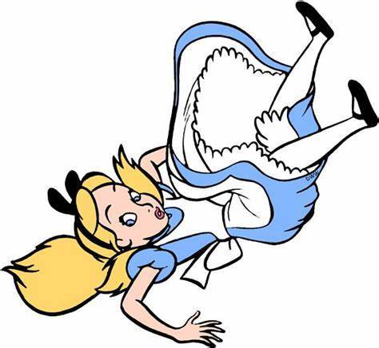
AI Visualize v. Nuance Communications
Alice and Subject Matter Eligibility (SME)
    Determine whether the patent is directed towards a patent ineligible concept, like an abstract idea
      Examine the focus of the claimed advance over the prior art.
      The focus must be on an improvement to the technologies, the specific means and methods to improve the technologies, or a technical solution to a technical problem
    Determine whether the claims individually or in ordered combination recite elements sufficient to transform it into a patentable subject matter
      Examine the claims for an inventive step that makes the claims patentable
      The claims do not recite an inventive step if the claim elements or ordered combinations of claim elements are routine, conventional or well-know in the prior art; or if the patentee cannot show a concrete application of an abstract idea

Slide 46

AI Visualizate v. Nuance Communications
Alice Step 1 – Directed to Patent Ineligible Subject Matter
AI Visualize (AIV) argued that the claims recite a technical solution to a technical problem of “creation of virtual views” as evidenced by the specification.
The Fed. Cir. rejected AIV’s argument: “we refuse to import details from the specification . . . there is no recitation in the claim about how to create frames or virtual views, much less in a manner that would meaningfully support a technical solution to a technical problem in the prior art.” AI Visualize, Inc. v. Nuance Commc'ns, Inc., 97 F.4th 1371, 1379 (Fed. Cir. 2024)
Patents directed to steps of obtaining, manipulating, and displaying data.
Alice Step 2 – Transformation to Patentable Subject Matter
AI Visualization argued creation of virtual views as an inventive step
The court rejected that argument because “virtual views were known in the art.” AI Visualize, Inc. v. Nuance Commc'ns, Inc., 97 F.4th 1371, 1380 (Fed. Cir. 2024)

Slide 47
Other SME Cases
Alice Step 1
In Chewy, rejecting IBM’s argument that the claims recite a specific solution to a technical problem the Fed. Cir. reasoned “the claims merely recite the concept of identifying advertisements based on search results, without any specificity as to how this is accomplished.” Chewy, Inc. v. International Business Machines Corporation 94 F.4th 1354, 1366 (Fed. Cir. 2024).
In Brumfield, the Fed. Cir. reasoned “nothing in the claims, understood in light of the specification, calls for anything but preexisting computers and displays, programmed using techniques known to skilled artisans, to present the new arrangement of information. Brumfield, Tr. for Ascent Tr. v. IBG LLC, 97 F.4th 854, 868 (Fed. Cir. 2024)
Alice Step 2
In Chewy, the court reasoned, “while IBM argues the claimed repository is specialized, this is not supported by the ’443 patent. Instead, the patent broadly refers to an “information repository” with no further details.” Chewy, Inc. v. International Business Machines Corporation 94 F.4th 1354, 1367 (Fed. Cir. 2024).
In Brumfield, the Fed. Cir. reasoned that in “the absence of an improvement in computer functionality, we conclude that the specific claim elements, “individually and as an ordered combination,” . . . do not add an inventive concept needed for eligibility. Brumfield, Tr. for Ascent Tr. v. IBG LLC, 97 F.4th 854, 868 (Fed. Cir. 2024)

Slide 48
AI Visualize v. Nuance Communications
Considerations
Draft claims in a manner that would support a technical solution to a technical problem. Not always easy to do; plenty of litigation around this issue.
A technical problem identified in the specification will not be imported into the claims. The technical problem and its solution must appear in the claims themselves.
Draft claims so that unconventional or non-routine aspects of how something is being used/done appear in the claims. For example, if the technical problem is “how a view is created,” be sure how the view is created is claimed, rather than that the view is created.

Slide 49
USPTO AI GUIDANCE
PATENT LAW

Slide 50
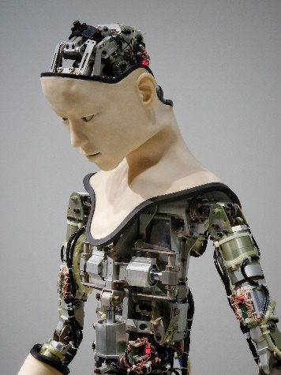
Thaler v. Vidal, 43 F.4th 1207 (Fed. Cir. 2022)
    Decision
    Stephen Thaler filed patent applications listing a device as the inventor
    Held that inventors be natural persons, i.e., human beings; Supreme Court denied Cert. April 23, 2023
    Declined to address whether inventions made by human beings with AI assistance are patent eligible
    USPTOs 2024 AI Guidance (AIG2024)
    §5 of Biden’s Executive Order 14110 on the “Safe, Secure, and Trustworthy Development and Use of Artificial Intelligence” (October 30, 2023) charged the USPTO with providing guidance on AI and inventorship, and patent eligibility
    Developed by monitoring judicial developments in subject matter eligibility, soliciting input from stakeholders, and hosting listening sessions
    Not intended to announce any new practice or procedure, meant to be consistent with existing guidance, but to the extent it is inconsistent, personnel are to follow AIG2024.
    Will be incorporated into the MPEP in due course

Slide 51
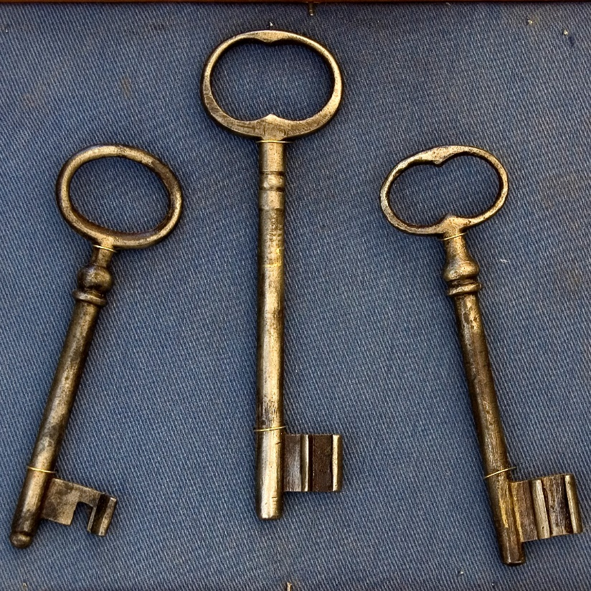
USPTO AI GUIDANCE – KEY TAKEAWAYS
Key 1: AI-assisted Inventions
  AI technologies are evaluated the same as other technologies
  The use of AI tools in development of technologies does not prevent eligibility provided there is significant human contribution
Key 2: Practical Application
  To overcome Alice, focus on practical applications. That is, write claims that provide a technical solution to a technical problem and emphasize improvements that result from the invention
Key 3: New Examples 47-49
  Show how to apply the SME analysis to AI related claims.
  Highlight ways of transforming an AI-related claims to be SME

Slide 52
Patent Case to Watch: University of California v. Broad Institute
  Longstanding dispute over who invented the use of CRISPR-Cas9 gene-editing system in eukaryotic cells
  Two previous PTAB interference proceedings held Broad as inventor
      Second proceeding held that conception requires inventors to reduce invention to practice, and that it is insufficient to simply know the invention will work.
  Oral argument in May 2024; pending opinion
      One of the issues argued was the legal standard for conception
      Judge suggested PTAB “cited the correct standard when reviewing who first invented a particular use of the gene-editing technology CRISPR-Cas9, but then applied an improper standard when ruling in favor of …[Broad].” (emphasis added) – Law360
  High stakes case as CRISPR has potential to revolutionize medicine and agriculture

Slide 53
  Brett Schuman
    Andrew Ong
    Goodwin Procter LLP
    bschuman@goodwinlaw.com
    aong@goodwinlaw.com

